Slide 1
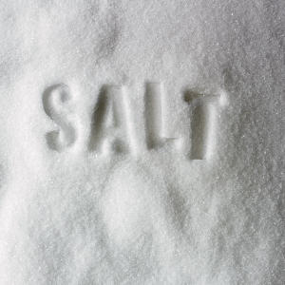

Slide 2
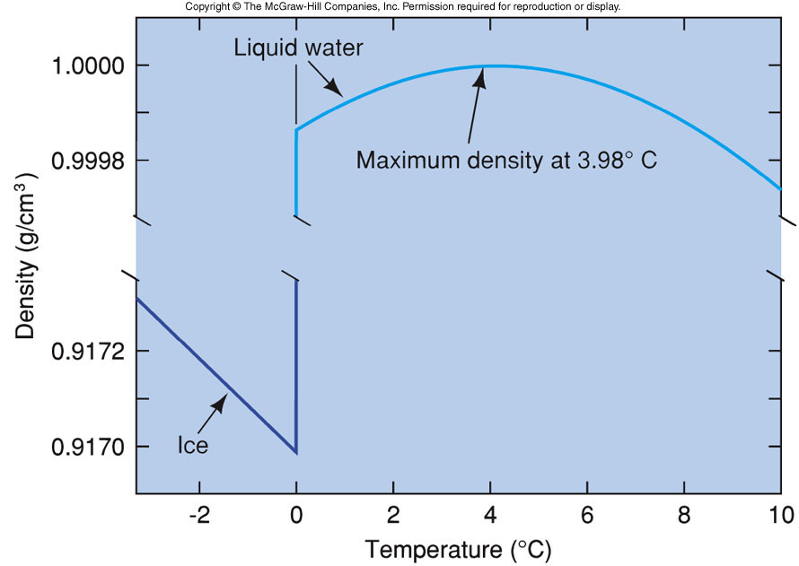
Density of Pure Water vs. Temperature

Slide 3
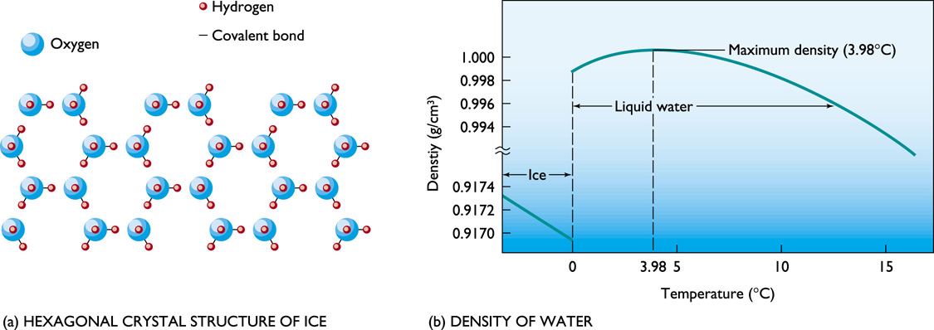

Slide 4
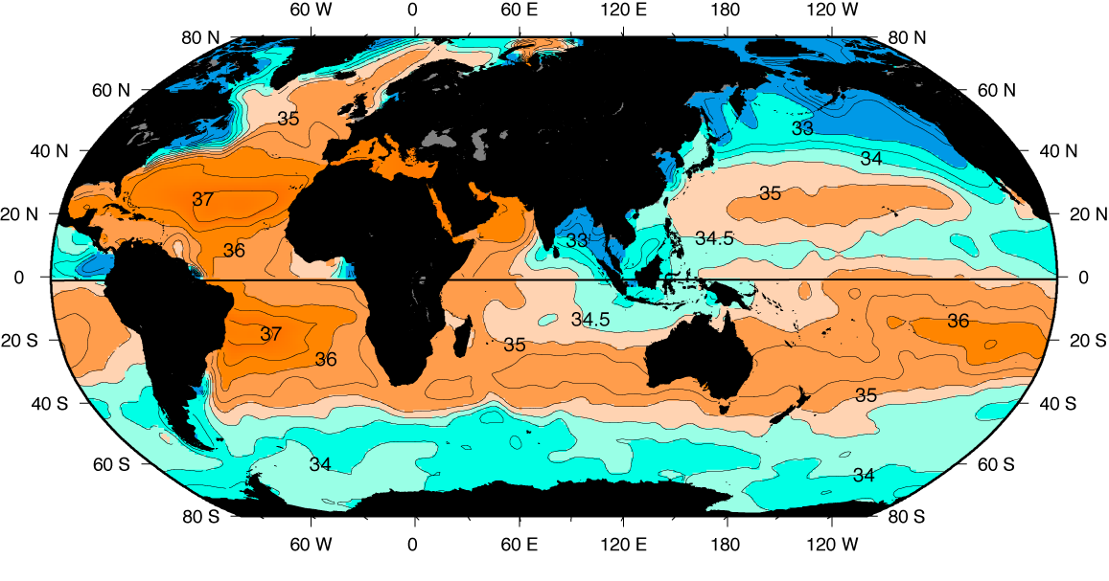
Why is the ocean salty?

Slide 5
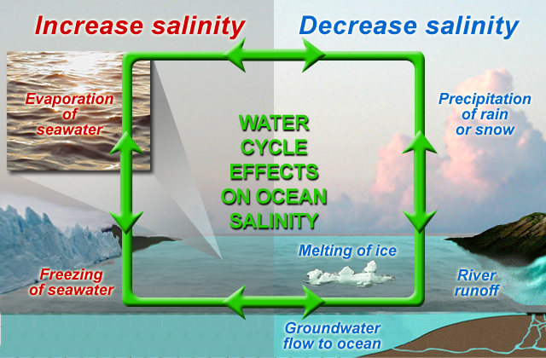

Slide 6
Salt Sinks
Salt sinks include the following:
Evaporation removes only water molecules.
Remaining water becomes increasingly saline, eventually producing a salty brine.
If enough water evaporates, the brine becomes supersaturate and salt deposits begin to precipitate forming evaporite minerals.
Wind-blown spray carries minute droplets of saltwater inland.
Adsorption of ions onto clays and some authigenic minerals.
Shell formation by organisms.

Slide 7
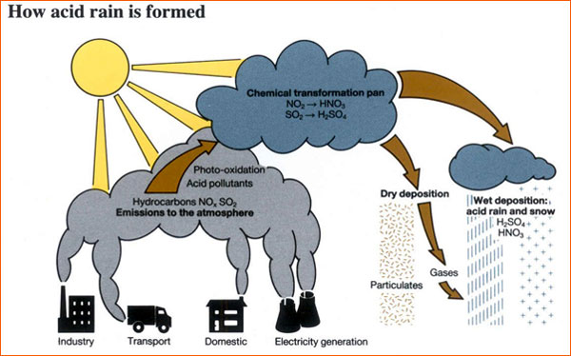
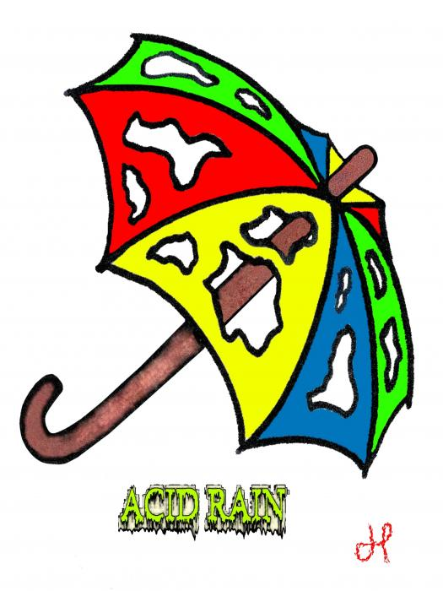
Weathering of Rocks
H₂O + CO₂ ---> H₂CO₃ (carbonic acid)
“acid” rain, pH ~4-5; environmental concerns (HCl, HF, H₂SO₄)
Dissolves rock minerals into ions, which travel down rivers to the ocean

Slide 8
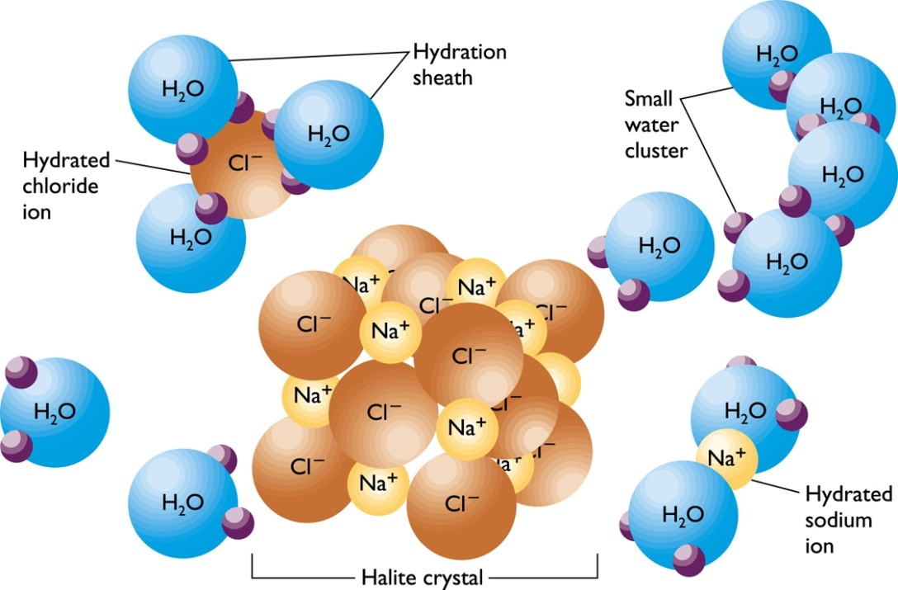
Dissolving Power of Water
Water dissolves salts by surrounding the atoms in the salt molecule and neutralizing the ionic bond holding the molecule together.
Dissolved salts form cations (positively charged ions) and anions (negatively charged ions).
The process of water surrounding an ion is called hydration.

Slide 9
The Most Abundant Ions
Chloride (Cl⁻) 19.0 g/kg
Sodium (Na⁺) 10.6
Sulfate (SO₄²⁻) 2.6
Magnesium (Mg²⁺) 1.2
Calcium (Ca²⁺) 0.4
Potassium (K⁺) 0.4 3.52 g/kg or ppt
Sodium and chlorine comprise 86% of the salt in the sea.
The major constituents of salinity display little variation over time and are a conservative property of sea water.

Slide 10
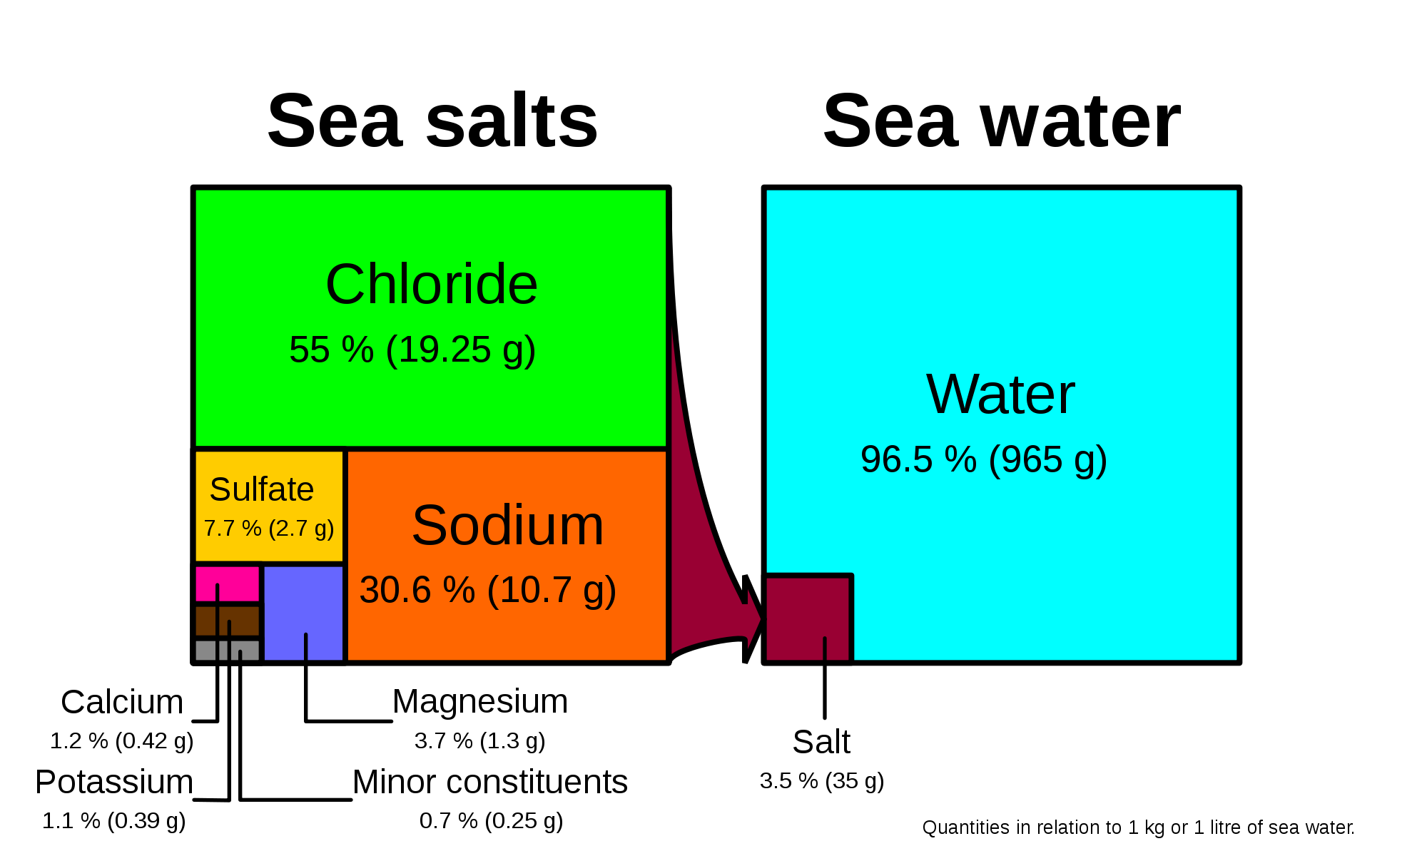

Slide 11
So what do I mean by salts?
“Salinity is the total mass, expressed in grams, of all substances dissolved in 1 kg of sea water”. Pre 2011 definition NOW its been changed to TEOS-10
Salinity is equal to 1.8065 x chlorinity.
The concept of salinity is useful because all of the constituents of sea salt are present in almost equal proportion everywhere in the ocean. This is an empirical “Law of equal proportions”
Law of equal proportions i.e. Ratio between ions never changes e.g., SO₄²⁻/Cl⁻ is a constant, independent of salinity
This means we need measure only one ion to get salinity
In the past salinity was measured quickly by electrical conductivity of sea water

Slide 12
Typical ocean salinity is 34 to 36 (i.e. 34 to 36 gm salt/kg seawater)
Measurements:
Oldest: evaporate the seawater and weigh the salts
Old: titration method to determine the amount of chlorine, bromie and iodine (prior to 1957)
Modern: Use seawater conductivity, which depends mainly on temperature and, much less, on salinity, along with accurate temperature measurement, to compute salinity.
Modern conductivity measurements:
(1) in the lab relative to a reference standard
(2) profiling instrument (which MUST be calibrated to (1))

Slide 13
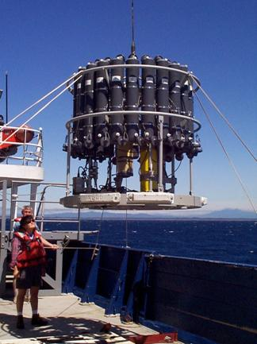
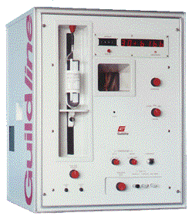
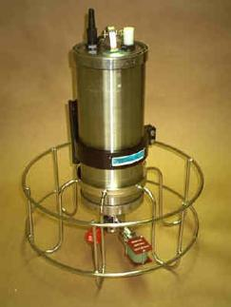
Salinity
CTD (conductivity, temperature, pressure) for measuring conductivity in a profile (on the fly)
Autosalinometer for running salinity analyses relative to standard seawater
Bottles for collecting water samples

Slide 14
Salinity accuracy and precision
Accuracy Precision
Old titration salinities (pre-1957)
0.025 psu 0.025 psu
Modern lab samples releative to reference standard
0.002 psu 0.001 psu
Profiling instruments without lab samples
? ?

Slide 15
New Salinity Measurement since 2011!!
Thermodynamic Equation of Seawater (TEOS- 10)
www.teos-10.org
A significant change compared with past practice is that TEOS-10 uses Absolute Salinity S_{A} (mass fraction of salt in seawater) as opposed to Practical Salinity S_{P}(which is essentially a measure of the conductivity of seawater) to describe the salt content of seawater. Ocean salinities now have units of g/kg.

Slide 16
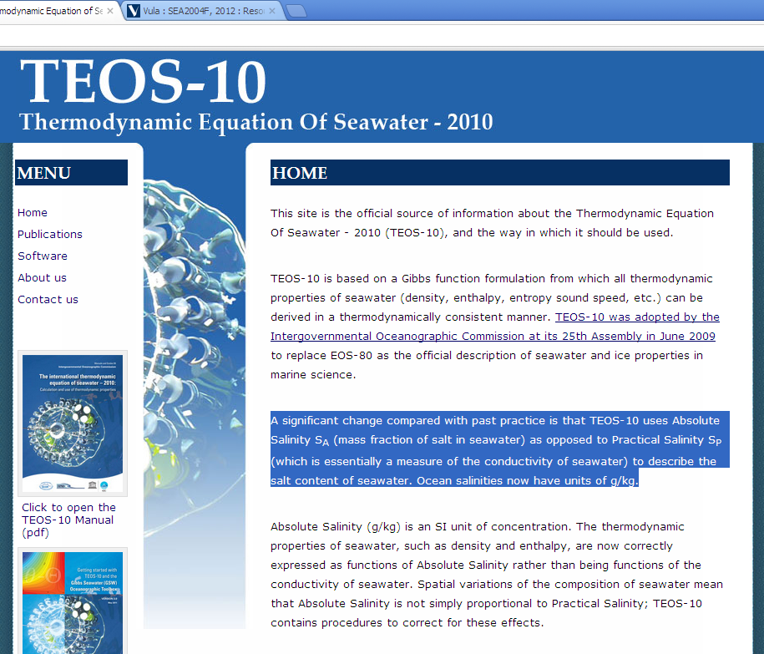

Slide 17
“Absolute salinity” (TEOS-10)
Absolute salinity = reference salinity + correction for other stuff
S_{A} = S_{R} + δS_{A}
Reference salinity S_{R} = 35.16504/35 * Practical salinity = 1.0047*psu
Reference salinity has been corrected for new knowledge (since 1978) about sea water stoichiometry as well as new published atomic weights.
The correction δS_{A} is for dissolved matter that doesn’t contribute to conductivity variations: silicate, nitrate, alkalinity
Millero et al. (2008), IOC, SCOR and IAPSO (2010), McDougall et al. (2010)

Slide 18
Is the salinity of the ocean changing over time?
• No, the ocean appears to be in chemical equilibrium
• The proportion and amounts of dissolved solids
remain constant over time
• This concept is known as the “steady-state ocean”
• Ions are added to and removed from the ocean at
about the same rates, so salinity stays about the same

Slide 19
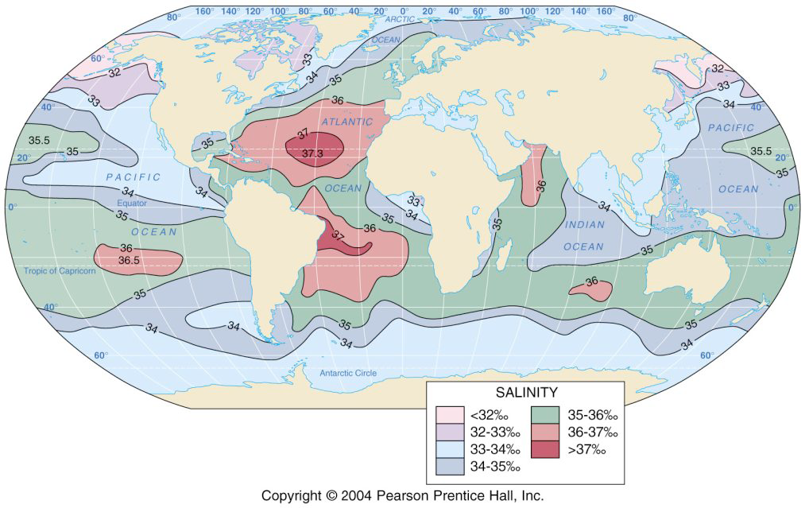
Variations in surface salinity

Slide 20
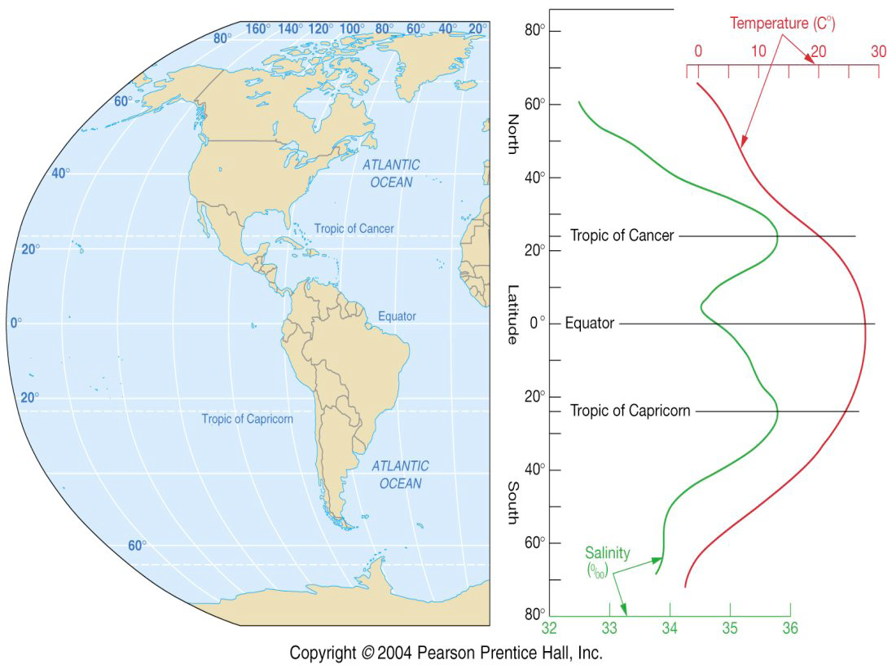
Dry air descends
Abundant precipitation
Dry air descends

Slide 21
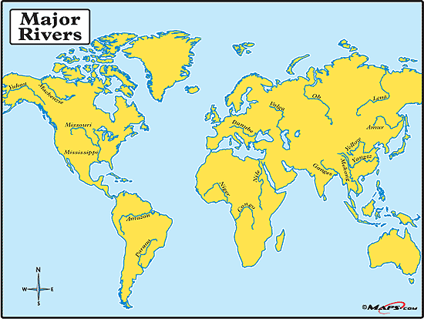
See the link with the distribution of major rivers!

Slide 22
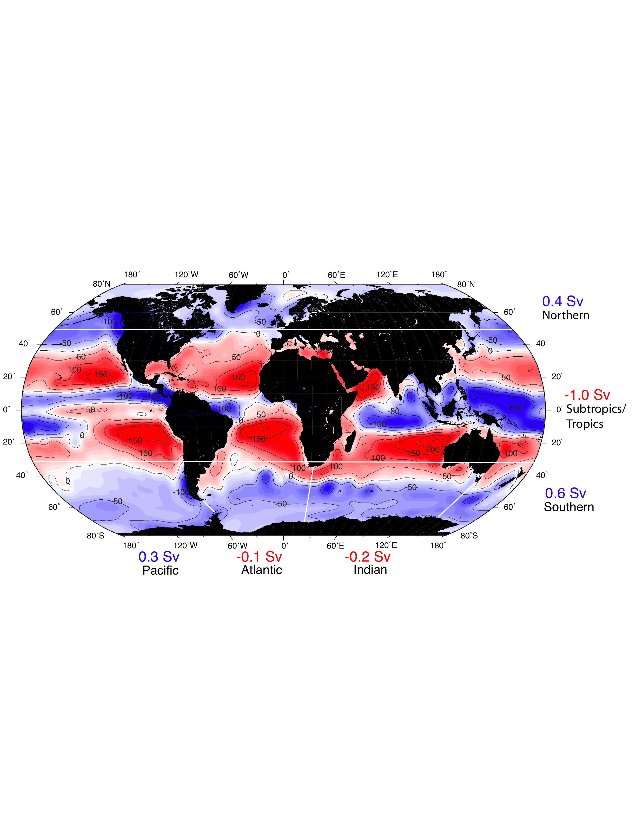
What sets salinity? Precipitation + runoff minus evaporation (cm/yr)
Salinity is set by freshwater inputs and exports since the total amount of salt in the ocean is constant, except on the longest geological timescales
NCEP climatology DPO 5.4

Slide 23
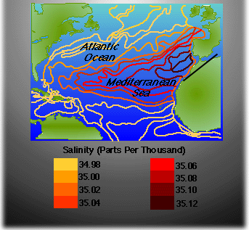
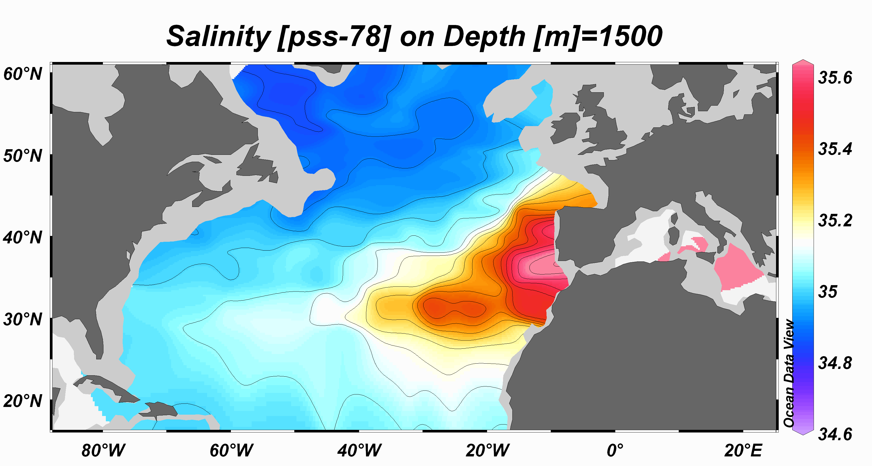

Slide 24
Variations in surface salinity

Slide 25
An example of the effects of salt!
Mediterranean is very salty (high evaporation)
Water that leaves Med is saltier than surrounding Atlantic
Sinks to ~1500 m

Slide 26
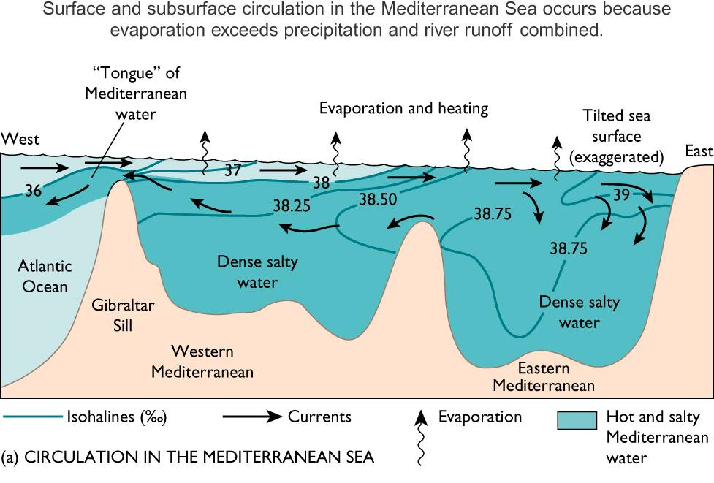
The outflow of Mediterranean Water

Slide 27
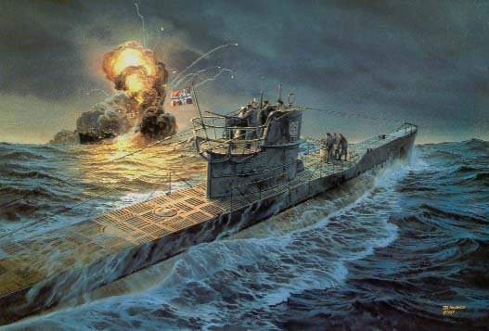
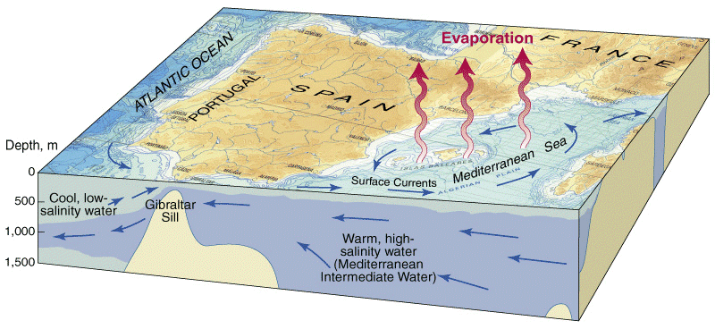
Here is an interesting story! During WW2 German U-Boats made use of the outflow of salty water from the Gibraltar Straits to the Atlantic to pass, undetected, the British Navy Shipping Fleet!!

Slide 28
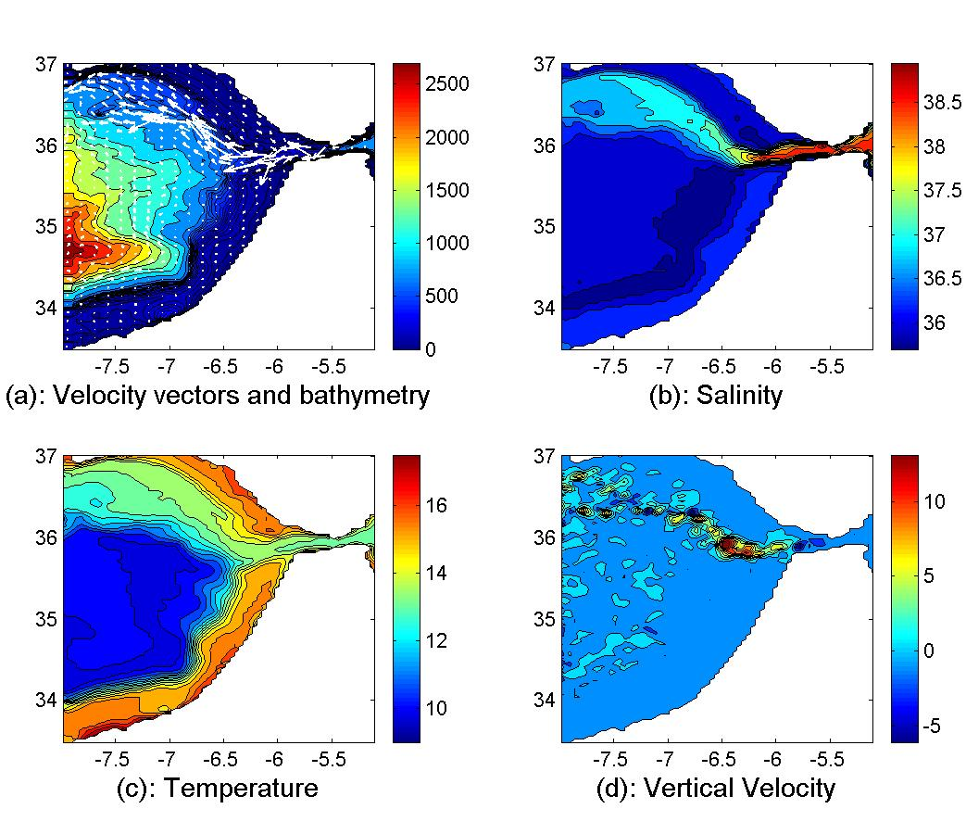

Slide 29
Vertical variations of salinity
Surface ocean salinity varies from ~33 - ~37 º/_{oo}
Deeper ocean salinity is nearly constant, ~35 º/_{oo}
Halocline, rapid change of salinity with depth

Slide 30
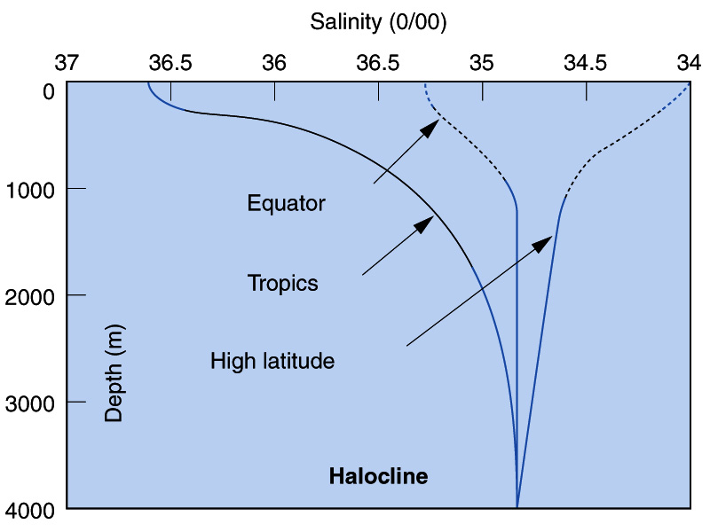

Slide 31
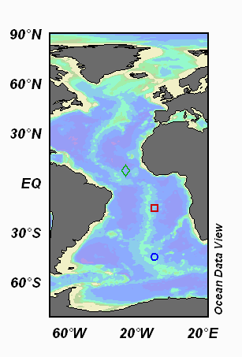
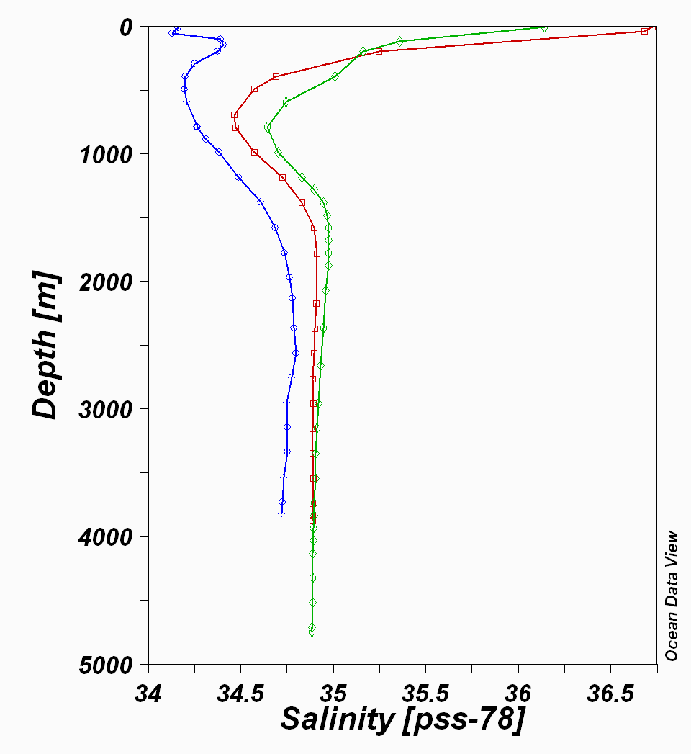

Slide 32
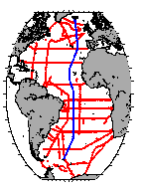
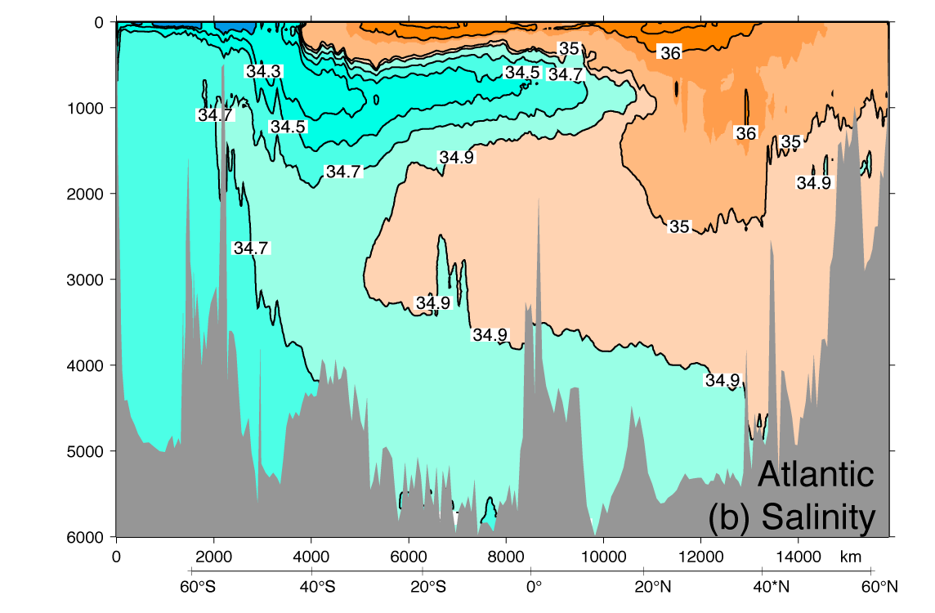
Atlantic salinity section

